Slide 1

ONLINE SALES DATA
BY
MUSINA.A

Slide 2

Online sales data refers to the collection of information generated from transactions made through E-commerce platforms, websites or mobile apps.
OBJECTIVES
To compare sales across different products or categories.
To find which product are generating the most revenue or quantity sold.
Analyzing this data helps businesses to understand their performance and customer behaviour.

Slide 3
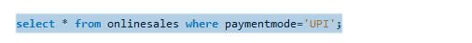

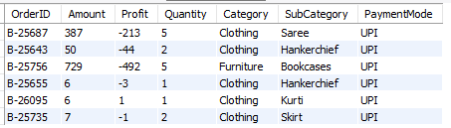
1.How do you select all sales where the payment mode is UPI?

Slide 4


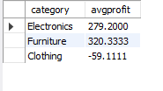
2. How to calculate average profit per category?

Slide 5


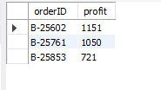
3. How can you retrieve the order IDs of the top 3 most profitable orders?

Slide 6


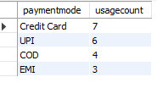
4. How to count the number of orders for each payment mode?

Slide 7

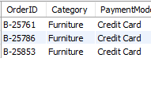

5.Display each order ID with category and payment mode for furniture orders which is paid using credit card?

Slide 8
CONCLUSION
The analysis of online sales data provides valuable insights into customer purchasing behaviour, popular product categories and preferred payment methods.
It reveals the most used payment modes(e.g., credit cards ,UPI).
It assists in making data- driven business decisions.

Slide 9
THANKYOU

